Slide 1
Project 4: PHP and Mysql Web Application
Integrated Systems Design 1: Databases

Slide 2
Project 4 Mission Description Steam Powered by William St Holl and Fernando Fernandez
In this assignment, we were tasked with designing and coding a community forum and database that could be applied to the Steam client. The ideology was to create a system that would be added to the client, and would record the different types of forums that are being created. The first step would be for to enter the forum database, then they would input their forum details. They would conclude by confirming their forum and a new forum would be compiled for others to comment in. This would help other users to find and discuss on other topic around the steam client, whether its to ask questions or to learn things about games; they could find any discussion essentially.

Slide 3
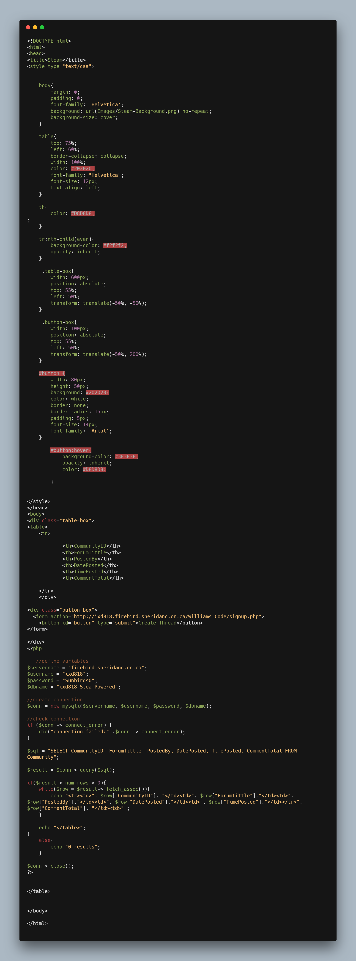
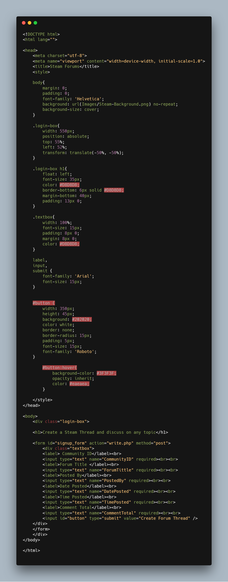
Source Code for index, read, forum
Inside of my brackets file, I had three different files: my index.php, signup.php and write.php. I entered different styling and created the links towards my cpanel server. This was the area where I was able to get my website to place data from the input forum section into my spl data base to be viewed upon at anytime. The code overall wasn’t to hard to understand, and it was fun creating my own template and seeing it work properly. The process of setting everything up was challenging, but oce that was complete everything was easier to complete

Slide 4
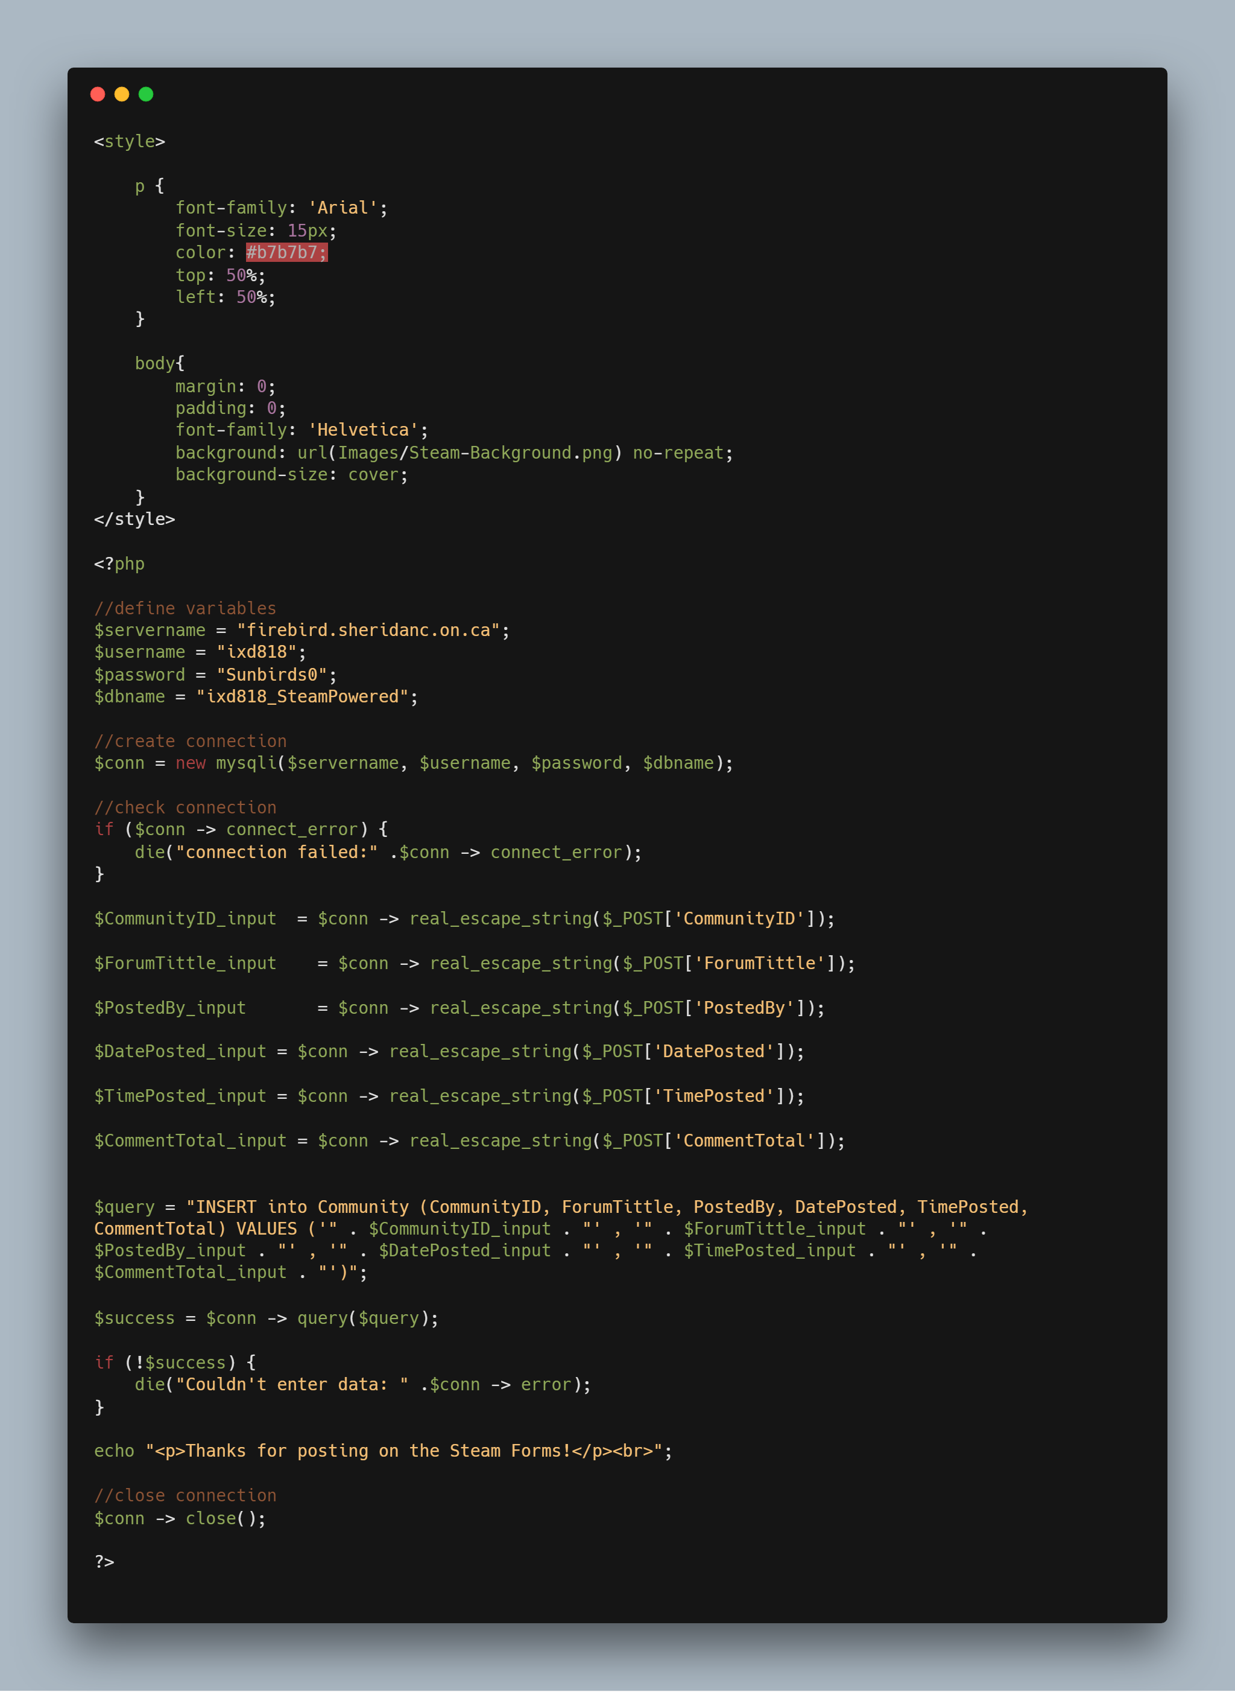
Source Code for index, read, forum
Inside of my brackets file, I had three different files: my index.php, signup.php and write.php. I entered different styling and created the links towards my cpanel server. This was the area where I was able to get my website to place data from the input forum section into my spl data base to be viewed upon at anytime. The code overall wasn’t to hard to understand, and it was fun creating my own template and seeing it work properly. The process of setting everything up was challenging, but oce that was complete everything was easier to complete

Slide 5
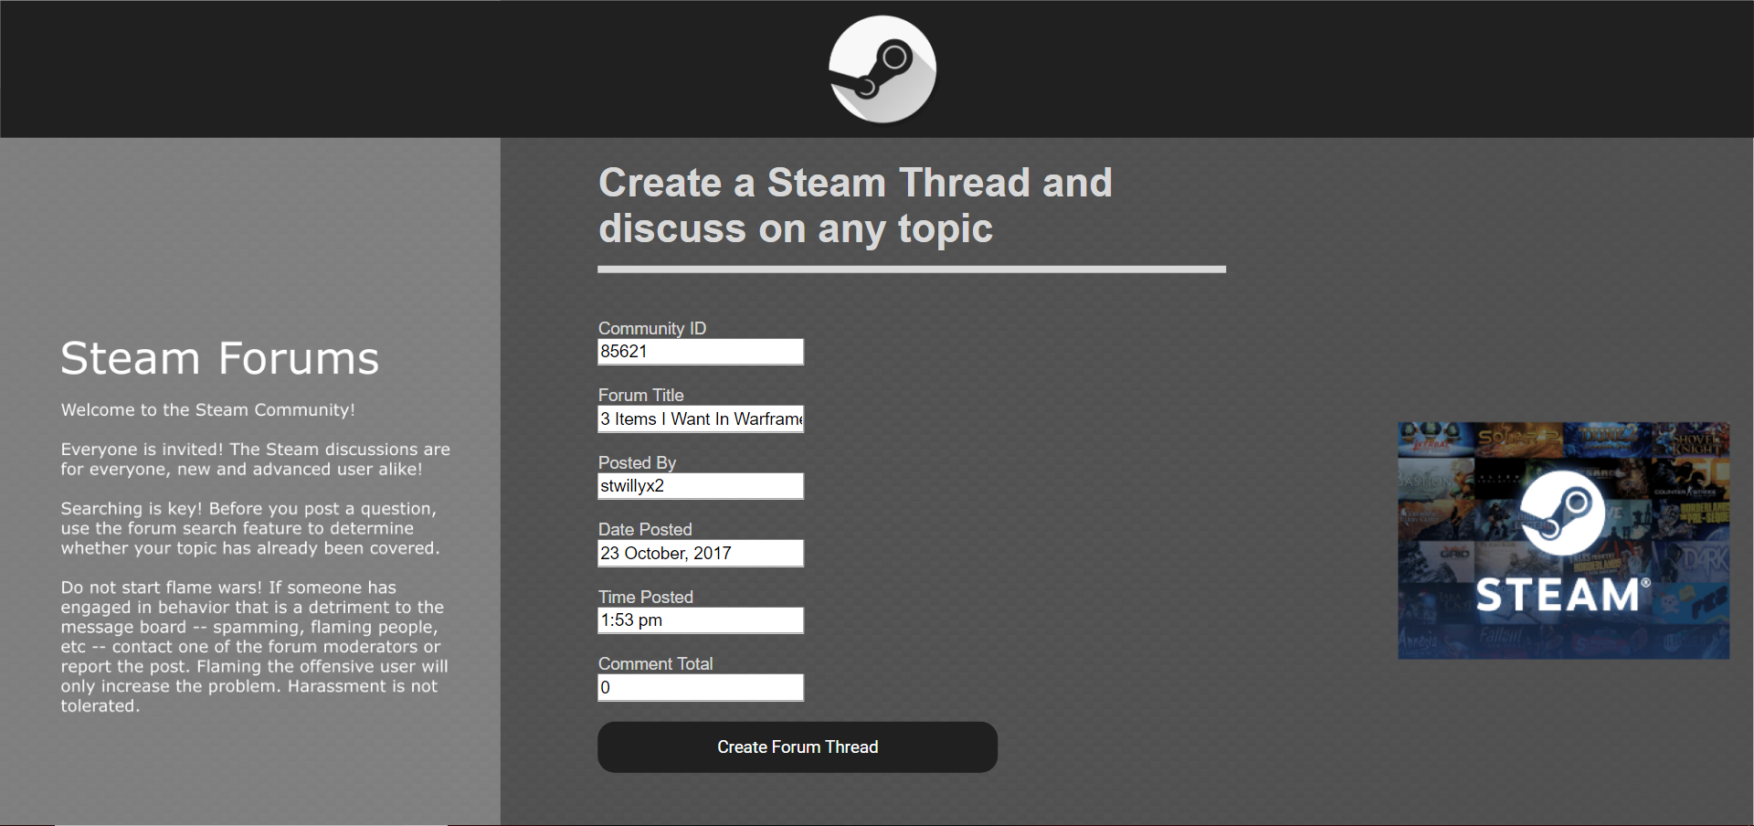
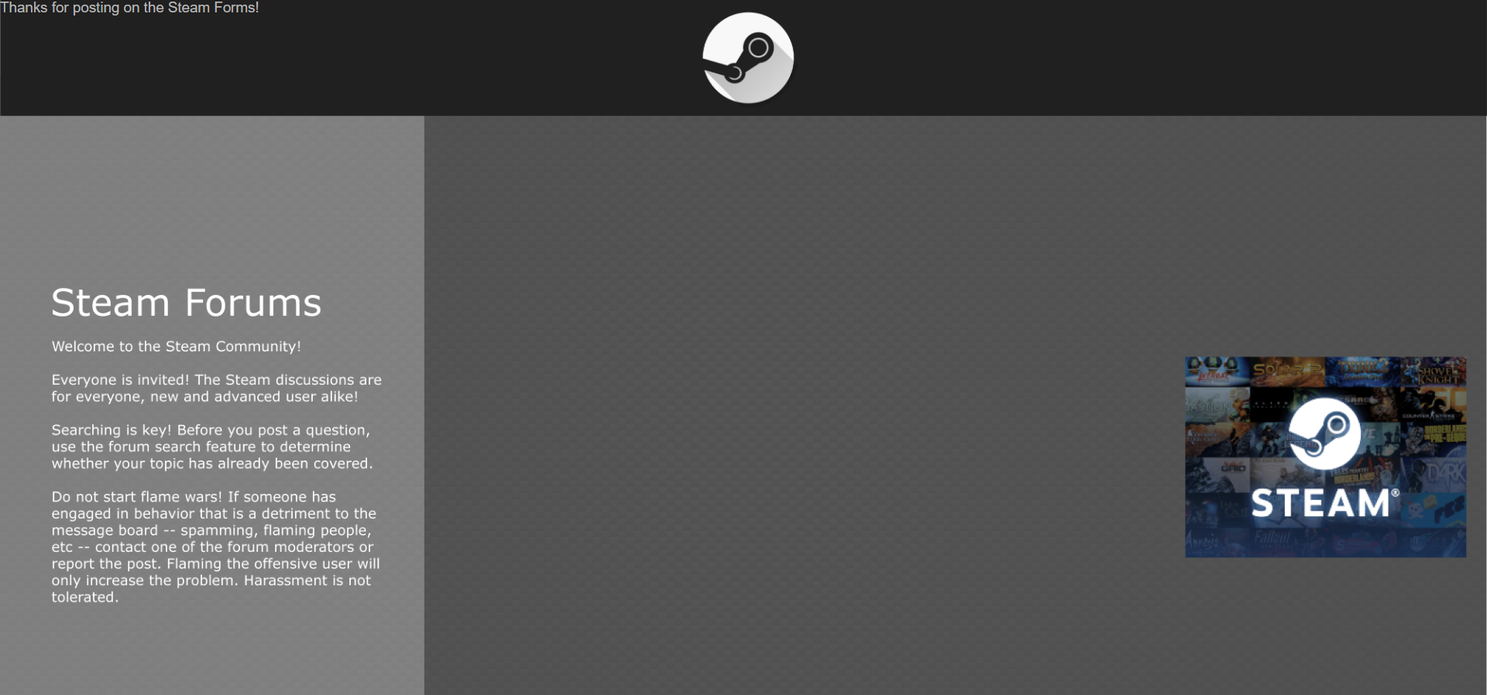
Ui Interface Images
User Inputting information
Complete Message

